Slide 1
Tutorial 7
Statistical Computation and Analysis
Spring 2025

Slide 2
Tutorial Outline
Simple linear regression
Bayesian p-value
Bayesian workflow
Data Transformation
Heteroskedsticity

Slide 3
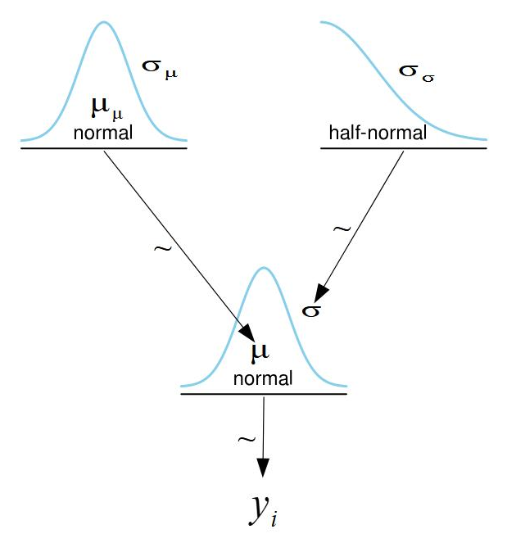

Simple Linear Regression
We have learned about normal models.
$$y_{i}\sim N\left(μ, σ\right)$$
$$μ\sim N\left(μ_{μ}, σ_{μ}\right)$$
$$σ\sim HalfNorm(σ_{σ})$$

Slide 4
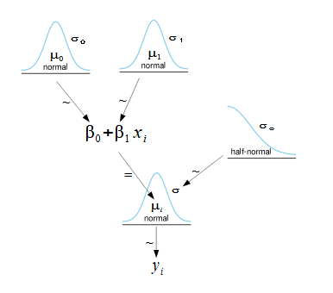

Simple Linear Regression
Now we’ll look at a case in which the mean depends on another variable.
Average height as a function of age.
$$y_{i}\sim N\left(μ_{i}, σ\right)$$
$$μ_{i}=β_{0}+β_{1}x_{i}$$
$$β_{0}\sim Prior0(θ_{0})$$
$$β_{1}\sim Prior1(θ_{1})$$
$$σ\sim Prior2(θ_{σ})$$

Slide 5


Simple Linear Regression
$$y_{i}\sim N\left(μ_{i}, σ\right)$$
$$μ_{i}=β_{0}+β_{1}x_{i}$$
$$β_{0}\sim N(μ_{0}, σ_{0})$$
$$β_{1}\sim N(μ_{1}, σ_{1})$$
$$σ\sim HalfNorm(σ_{σ})$$
Compare:
$$y_{i}\sim N\left(μ, σ\right)$$
$$μ\sim N\left(μ_{μ}, σ_{μ}\right)$$
$$σ\sim HalfNorm(σ_{σ})$$

Slide 6
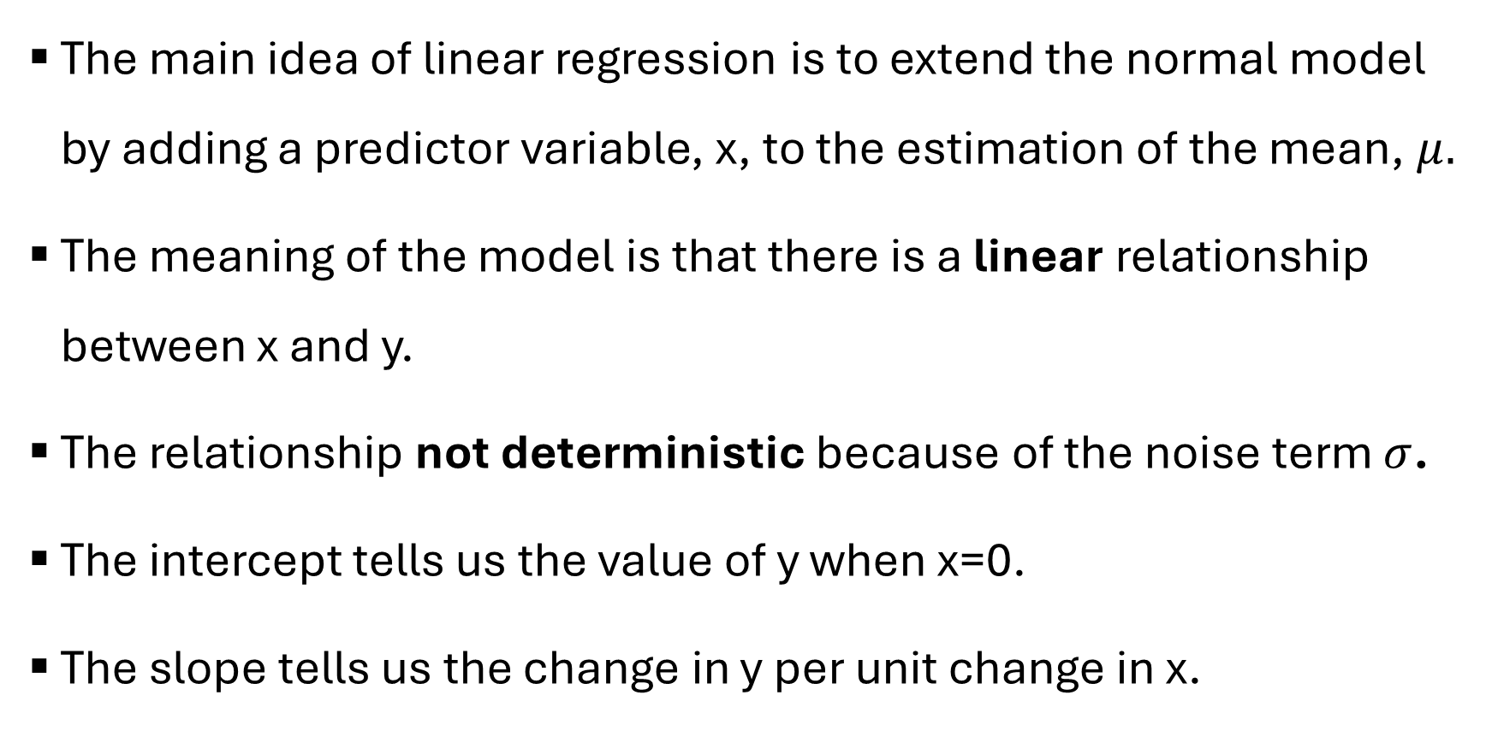
Simple Linear Regression
The main idea of linear regression is to extend the normal model by adding a predictor variable, x, to the estimation of the mean, $μ.$
The meaning of the model is that there is a linear relationship between x and y.
The relationship not deterministic because of the noise term $σ$.
The intercept tells us the value of y when x=0.
The slope tells us the change in y per unit change in x.

Slide 7
Simple Linear Regression
How do we write this model in our code?
We use a deterministic variable
coords = {"data": np.arange(len(x))}
with pm.Model(coords=coords) as model_lb:
β0 = pm.Normal("β0", mu=0, sigma=100)
β1 = pm.Normal("β1", mu=0, sigma=10)
σ = pm.HalfNormal("σ", 10)
μ = pm.Deterministic("μ", β0 + β1 * x, dims="data")
y_pred = pm.Normal("y_pred", mu=μ, sigma=σ, observed=y, dims="data")
)

Slide 8
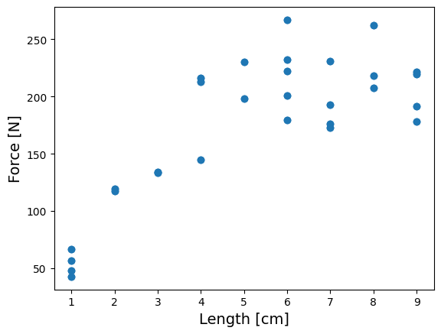
Simple Linear Regression
A group of researches checked the connection between the muscle length and the generated force.

Slide 9
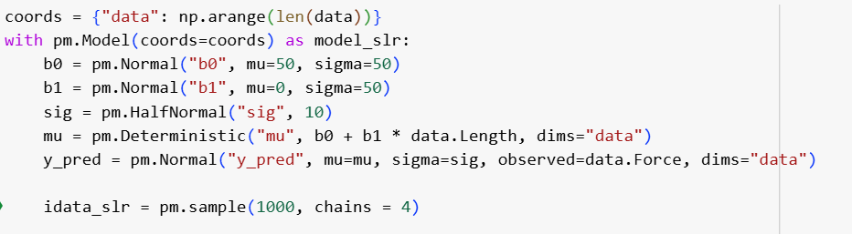
Simple Linear Regression
We can see an increase in generated force for increased muscle length.
Let’s model it using simple linear regression.

Slide 10
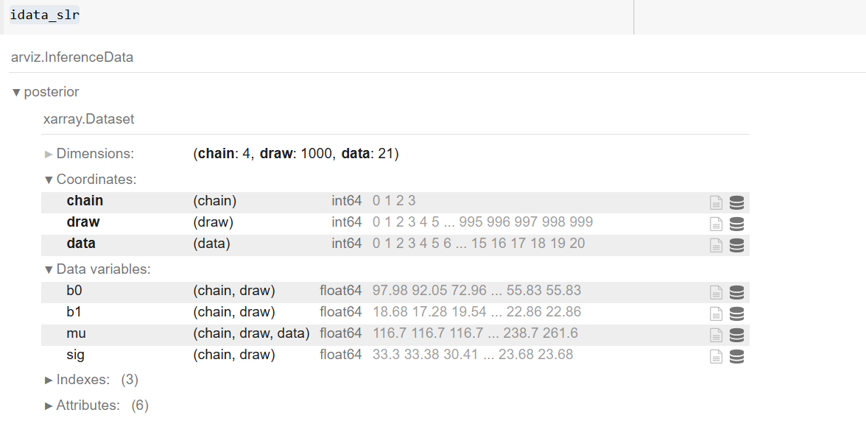
Simple Linear Regression
Look at our inference object:

Slide 11
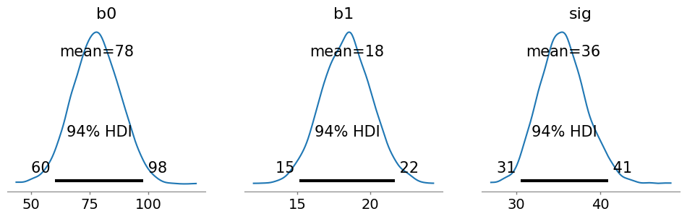

Simple Linear Regression
Look at the posteriors for each of our parameters:
If we take the mean of each distribution: $μ=64+22x$
But there are distributions for the intercept and the slope, so we can also take other values.

Slide 12
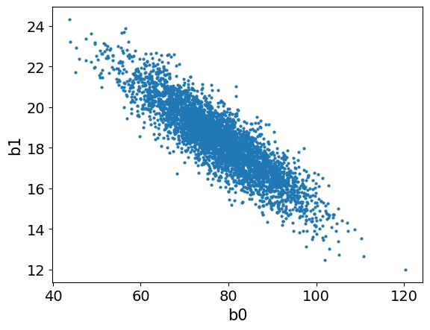
Simple Linear Regression
The samples are from the joint distribution and the parameters by be correlated.

Slide 13
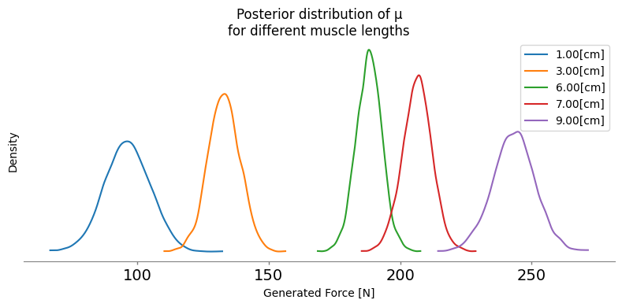

Simple Linear Regression
We have a distribution of $μ$ for each value of x (muscle length).
Some examples:

Slide 14
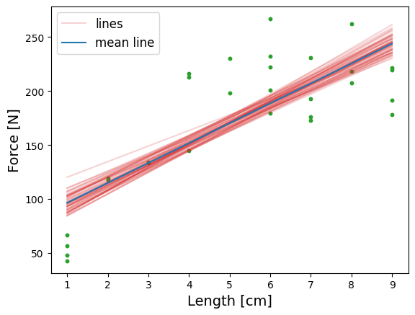
Simple Linear Regression
Let’s plot some possible regression lines using samples from the posterior.
This demonstrates the uncertainty we have regarding the values of the parameters.

Slide 15
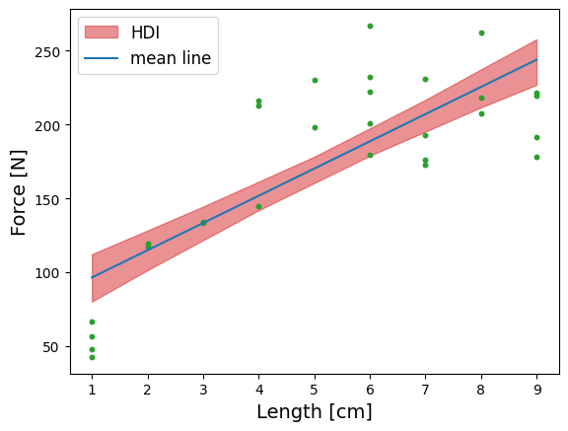
Simple Linear Regression
We can also look at the HDI for the regression line.
Notes:
Notice that if you repeat the code to
generate the plot, you will get different lines, because we are sampling from the posterior.
The shaded area, however, will be the same, because we are using all the available posterior
samples. If we go further and refit the model, we will not only get different lines but the
shaded area could also change, and probably the difference between runs is going to be very small (if not – increase number of samples or check if there is something wrong with the model or the sampling).

Slide 16
Simple Linear Regression
There are a lot of possible regression lines that can make sense given the analysis.

Slide 17
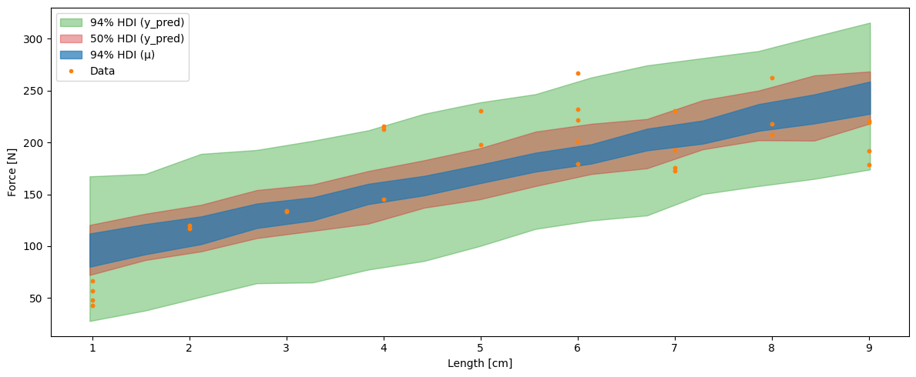
Simple Linear Regression
Posterior predictive sampling:
Sample from the posterior distribution of the parameters
Sample from the likelihood given these posterior samples

Slide 18
Simple Linear Regression
Posterior predictive sampling:
Visualizes the uncertainty in both posterior mean and posterior predictive.
50% of the data should in the 50% posterior predictive HDI
Posterior predictive should not have empty areas

Slide 19
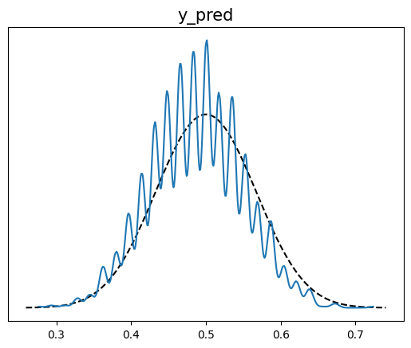
Bayesian p-value
What percentage of posterior predictive values are less than actual data values?
We expect that it should be around half.
We get a distribution over posterior predictive sets.

Slide 20
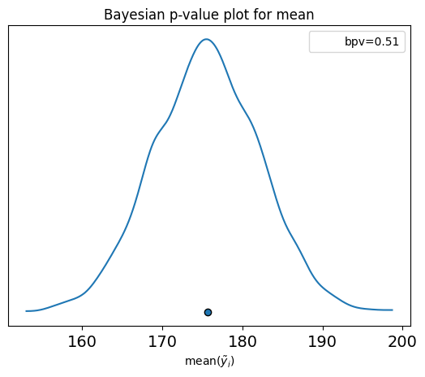
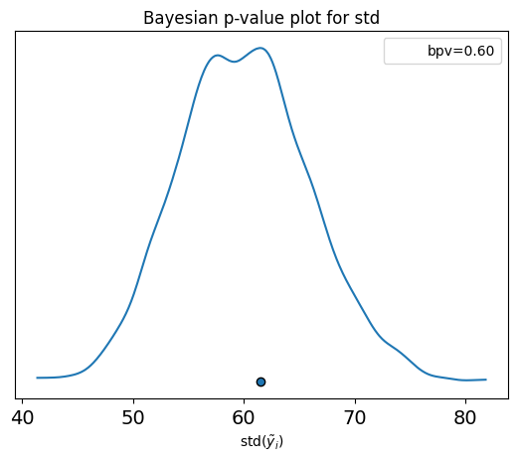
Bayesian p-value
Instead of comparing value by value, we can compare for chosen statistics, such as the mean and the standard deviation.
The dot is the value for our observed data.
The distributions are those of the statistic for each generated dataset.

Slide 21
Bayesian Workflow
Diagnostics
Data
Model
Sample
Posterior
Inference
Posterior predictive sampling
Prior predictive sampling

Slide 22
The steps in the Bayesian workflow
Step | Test | Solutions
Data collection | Data validation procedures | Improve methodology Develop protocols Document processes
Propose model | Generate graph Take sample | Test dimensions Debug
Sample prior predictive | Prior predictive plots | Simplify model Change priors
Sample posterior | Trace plots Rhat ESS MCSE Divergences | Improve sampling Change initialization Reparameterize model Simplify model Change priors
Sample posterior predictive | Posterior predictive plots Bayesian p values | Change model

Slide 23
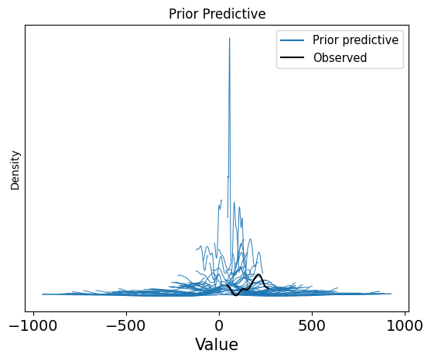
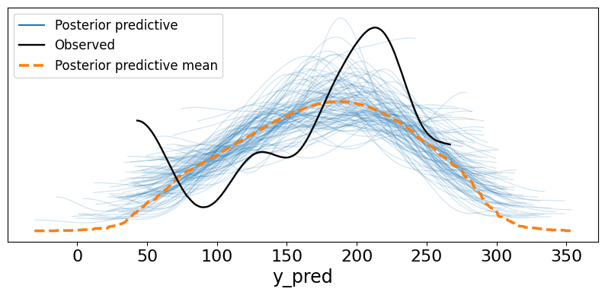
Prior and Posterior Predictive

Slide 24
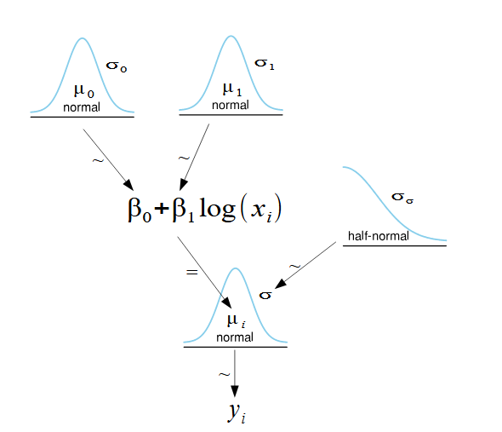

Data transformation
We can compute a transformation on our data.
$$y_{i}\sim N\left(μ_{i}, σ\right)$$
$$μ_{i}=β_{0}+β_{1}log⁡(x_{i})$$
$$β_{0}\sim N(μ_{0}, σ_{0})$$
$$β_{1}\sim N(μ_{1}, σ_{1})$$
$$σ\sim HalfNorm(σ_{σ})$$

Slide 25
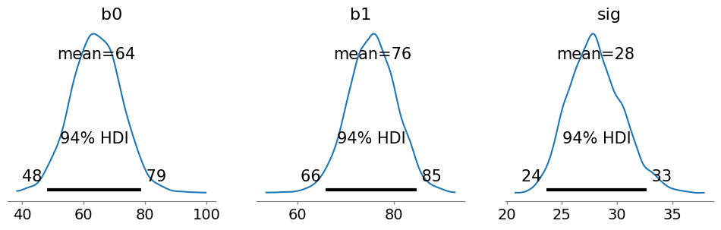
Data transformation
Look at the posteriors for each of our parameters:

Slide 26
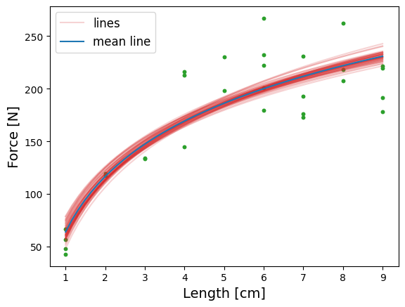
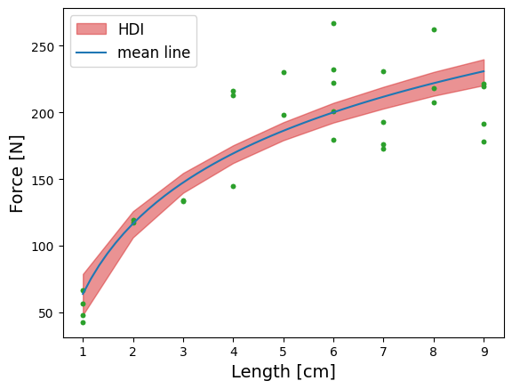
Data transformation
Possible regression lines using samples from the posterior + HDI:

Slide 27
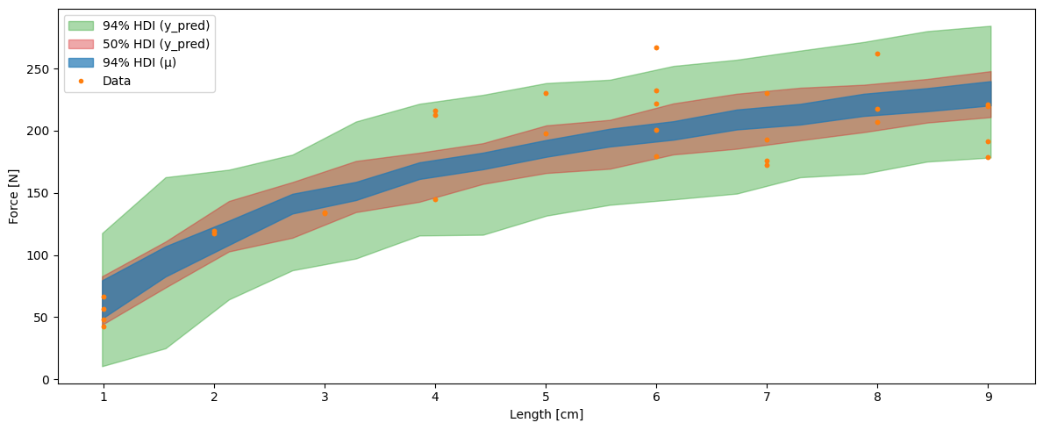
Data transformation
Posterior predictive sampling:

Slide 28
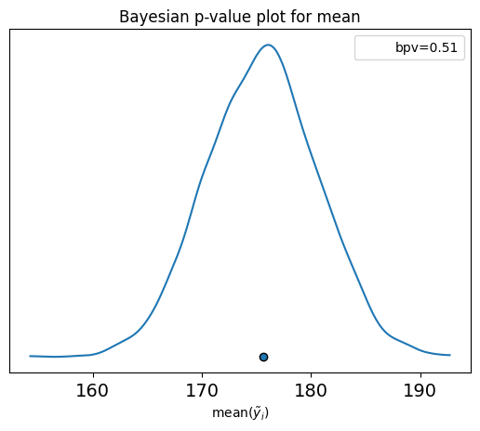
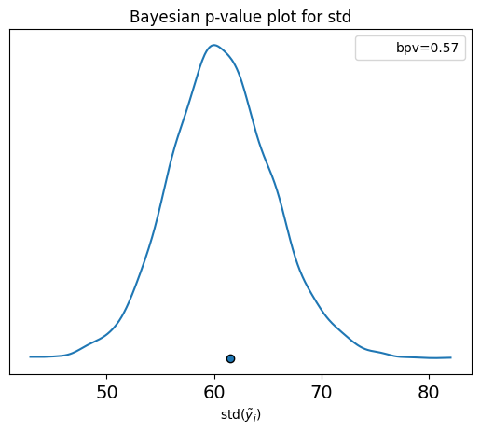
Data transformation
Bayesian p-value:

Slide 29
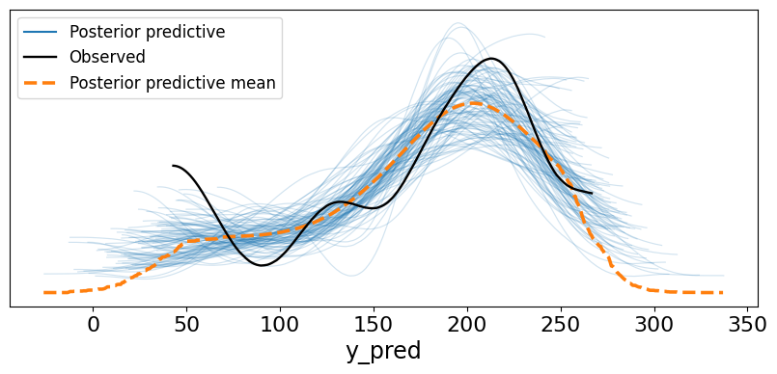
Data transformation
Posterior predictive:

Slide 30
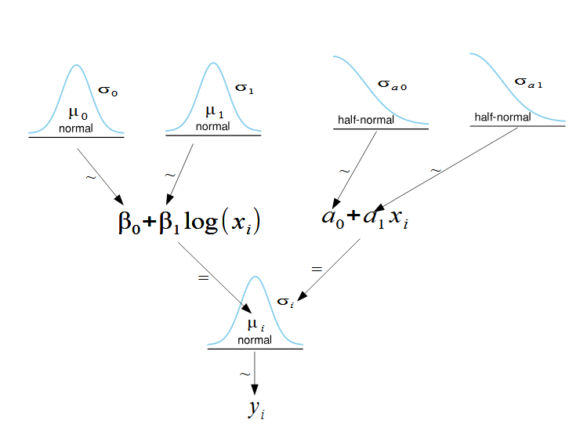
Heteroskedsticity
The variance also depends on the independent variable.

Slide 31
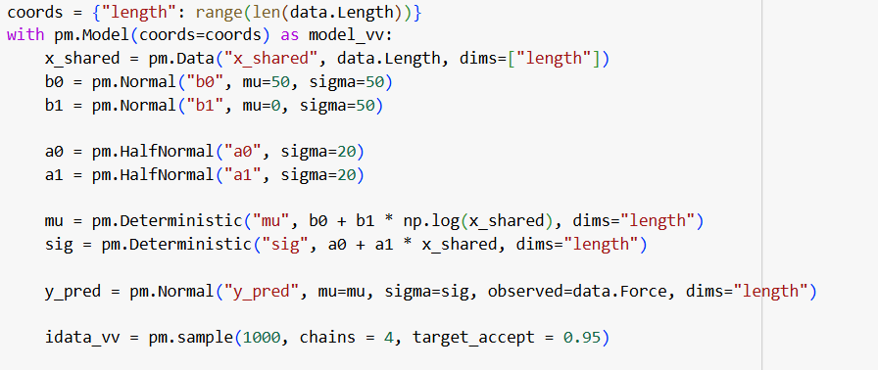
Heteroskedsticity

Slide 32
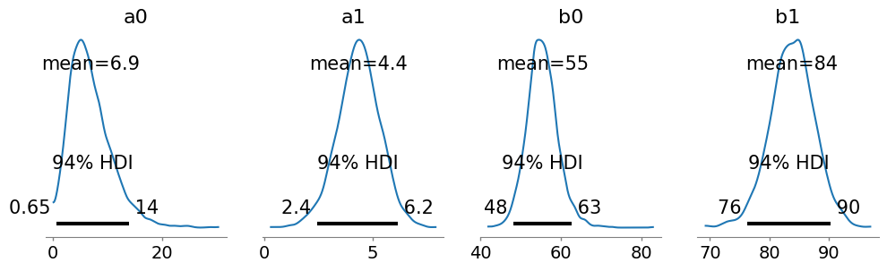
Heteroskedsticity
We can look at the posterior distributions for our parameters.

Slide 33
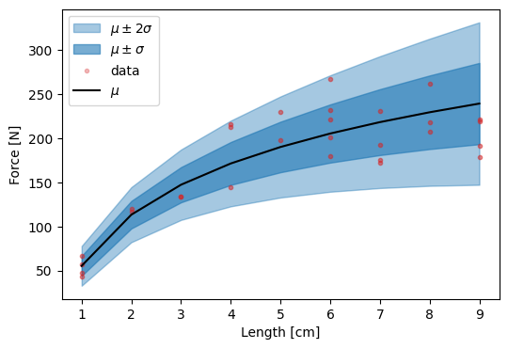
Heteroskedsticity
And our final result:

